Slide 1
Final Project RoundTable
Nandita Kohli

Slide 2
Idea 1 Overview
Pull article data from three different news outlets and rotate through
CNN, MSNBC, Fox
Count how many times key words and phrases are used pertaining to Trump
Have words floating on page and change word size based on the number of times it is used in articles
Rotate through years, font changes each time year changes
Color changes each time news station changes
Shows amount of media coverage

Slide 3
Idea 1 Details
Tentative List of 20 words to track:
Trump
Make America Great Again
MAGA
Putin
Allegations
Vote
Elections
Campaign
scandal
twitter
GOP
Democrats
Democracy
National security
Shooting
Deal
Business
Gerrymandering
Politicize
Fake news
Or should they be chosen by highest repeat in articles?

Slide 4
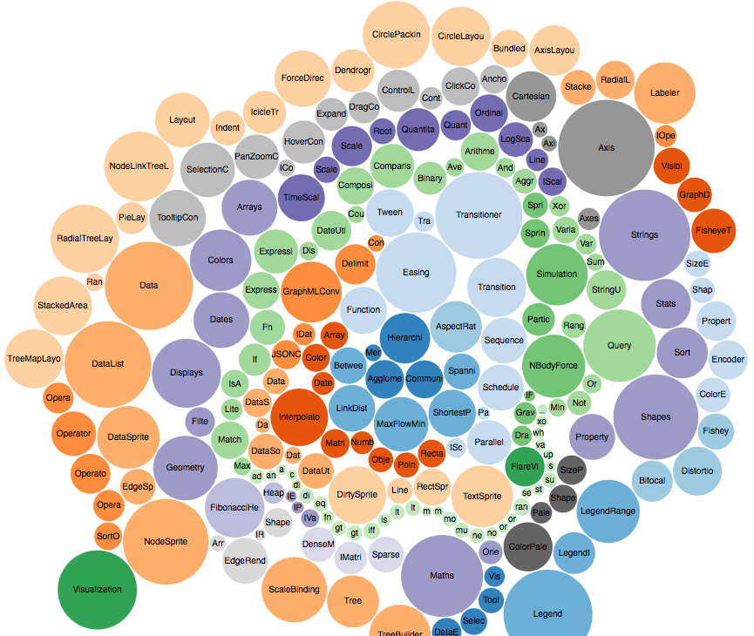
Idea 1 Inspiration
Jer Thorp
https://www.jerthorp.com/exo
How America Runs: https://flowingdata.com/2015/12/15/a-day-in-the-life-of-americans/
On Flowing Data: https://medium.com/@EvanSinar/use-animation-to-supercharge-data-visualization-cd905a882ad4

Slide 5
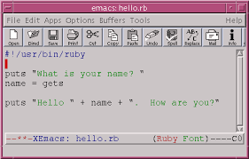
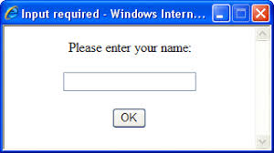
Idea 2 Overview
Create flowing map with user inputs
Each time a person inputs a country or place, the map draws a line from here (NY) to said place
Creates a web of places the user has traveled

Slide 6
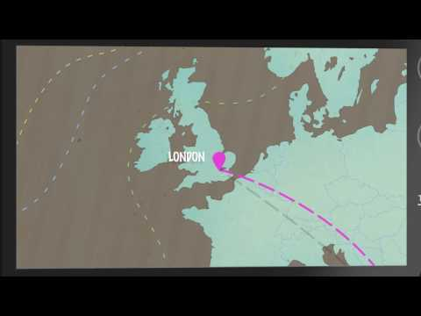
Idea 2 Details
https://www.youtube.com/watch?v=IdkSar74c2k

Slide 7
Idea 2 Inspiration
Jer Thorp: https://vimeo.com/4587178

Slide 8
Idea 3 Overview
Based on click by user, make different poems appear on screen in falling pattern
Perhaps scrape this website: https://www.poetryfoundation.org/poetrymagazine
Want to combine shapes and poetry to aid in self-discovery

Slide 9
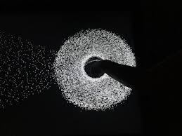
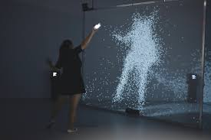

Idea 3 Details
Body shape? Shapes you make with mouse?
3D Shapes already embedded?
Found poetry - find different poems inside of poems?
Artechouse: fall into a poem:

Slide 10
Idea 3 Inspiration
Yoon Chung Han Eye: http://codame.com/projects/eyes
Combined bio and art and music to show discovery of self
Combine shapes and poetry to discover self
Jer Thorp
https://www.jerthorp.com/salesman

Slide 11
Idea 4 Overview
Create a data picture
Landscape of a place with animation
Numbers and statistics on everything about said thing
User interactivity -- when click goes inside…
Perhaps use 5 different screens
Perhaps NYC? Or NYU? Or Tandon?

Slide 12
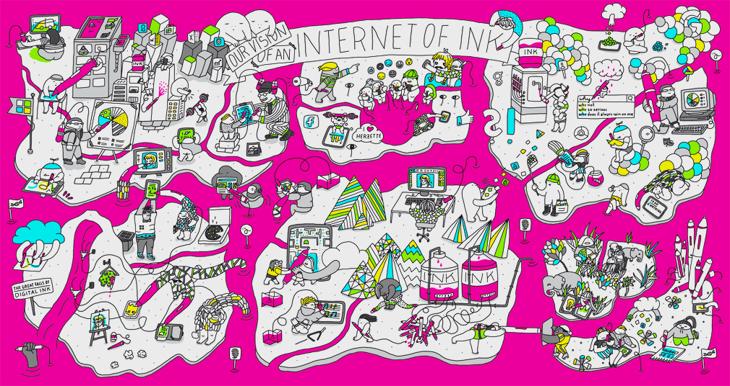


Idea 4 Detail
Word World: https://www.youtube.com/watch?v=nmtsFnCYDHc
Congaz: http://www.congaz.de/film-animation/project/wacom-internet-of-ink-ifa-2016/

Slide 13
Idea 4 Inspiration
John Green Theme Songs: https://www.youtube.com/watch?v=TcGnst1qnsQ
Thought Cafe work: https://vimeo.com/213745202

Slide 14
Idea 1 Research & Tools
Tools:
Google Developer on Data Charts: https://developers.google.com/chart/interactive/docs/basic_interactivity
Research:
https://www.cnn.com/2018/11/13/media/cnn-sues-trump/index.html
http://www.msnbc.com/topics/donald-trump
https://www.foxnews.com/entertainment/cnn-files-lawsuit-against-trump-administration-to-restore-jim-acostas-white-house-credential
CNN API: https://newsapi.org/s/cnn-api
MSNBC API: https://newsapi.org/s/msnbc-api
Fox News API: https://newsapi.org/s/fox-news-api

Slide 15
Idea 2 Research & Tools
Animated European History Map: http://www.visualcapitalist.com/2400-years-of-european-history/
Flight Maps Article gifs: http://metrocosm.com/globe-air-traffic-particles/

Slide 16
Idea 3 Research & Tools
https://www.poetryfoundation.org/poetrymagazine
http://poems.com/

Slide 17
Idea 4 Research & Tools
Research:
http://www.localhistories.org/newyork.html
https://www.nyu.edu/faculty/governance-policies-and-procedures/faculty-handbook/the-university/history-and-traditions-of-new-york-university/a-brief-history-of-new-york-university.html
https://engineering.nyu.edu/academics/departments/electrical-and-computer-engineering/department-history
Resources:
Expos professors, history professors, and older students

